Slide 1
Optimizing Apache Spark
The Five Most Common Performance Problems
Shuffles

Slide 2
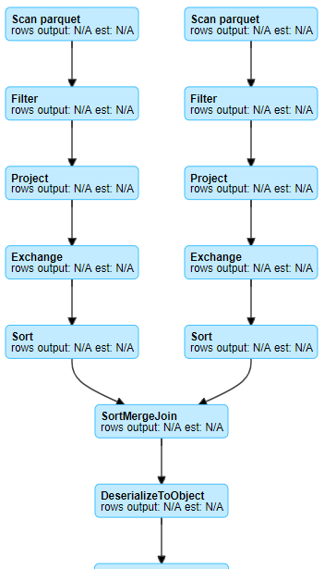
The 5 Most Common Performance Problems (The 5 Ss)
Shuffle
Shuffling is a side effect of wide transformation:
join()
distinct()
groupBy()
orderBy()
And technically some actions, e.g. count()

Slide 3
Let’s take a look at how a shuffle works...

Slide 4
Step #1: From source or another stage, the process is the same
Stage 1
Stage 2
?
Read
Read
Notes:
We are going to read the data from somewhere
It might be from S3 or it could be the shuffle files from the previous stage
In either case, the pattern is the same

Slide 5
Step #2: Read the data into Spark-Partitions
Stage 1
Stage 2
Read
Read

Slide 6
Step #3: Map reach record (e.g. by key) to a new partition
Stage 1
Stage 2
Read
Read
Map Shuffle Reduce

Slide 7
Step #4-A: Read the shuffle files into the next stage
Stage 1
Stage 2
Read
Read
Map Shuffle Reduce

Slide 8
Step #4-B: Stage-1 would have written the shuffle files
Stage 1
Stage 2
Read
Read
Map Shuffle Reduce

Slide 9
Step #4-C: Stage-2 would have read the shuffle files
Stage 1
Stage 2
Read
Read
Map Shuffle Reduce

Slide 10
Step #4-D: Done simultaneously, this is a blocking operation
Stage 1
Stage 2
Read
Read
Map Shuffle Reduce

Slide 11
Step #5: The partitions are “reduced”, how varies
Stage 1
Stage 2
Read
Read
Map Shuffle Reduce

Slide 12
Step #6: The final result is a new set of partitions
Stage 1
Stage 2
Read
Read
Map Shuffle Reduce

Slide 13
Step #7: New transformations can then be applied...
Stage 1
Stage 2
Read
Write
Read
Write
Map Shuffle Reduce

Slide 14
The 5 Most Common Performance Problems (The 5 Ss)
Shuffle - Not all the same
The distinct operation aggregates many records based on one or more keys (the distinguisher) and reduces all duplicates to one record
The groupBy / count combination aggregates many records based on a key and then returns one record which is the count of that key
The join operation takes two datasets, aggregates each of those by a common key and produces one record for each matching combination (total record count = max of a.count and b.count)
The crossJoin operation takes two datasets, aggregates each of those by a common key, and produces one record for every possible combination (total record count = a.count x b.count)

Slide 15
The 5 Most Common Performance Problems (The 5 Ss)
Shuffle - Similarities
They read data from some source
They aggregate records across all partitions together by some key
The aggregated records are written to disk (shuffle files)
Each executors read their aggregated records from the other executors
This requires expensive disk and network IO

Slide 16
The 5 Most Common Performance Problems (The 5 Ss)
Shuffle - Being Pragmatic
There are some cases in which a shuffle can be avoided or mitigated
TIP: Don’t get hung up on trying to remove every shuffle
Shuffles are often a necessary evil
Focus on the [more] expensive operations instead
Many shuffle operations are actually quite fast
Targeting skew, spill, tiny files, etc often yield better payoffs

Slide 17
What can we do to mitigate the impact of shuffles?
Notes:
Let the students speculate !!!

Slide 18
The 5 Most Common Performance Problems (The 5 Ss)
Shuffle - Mitigation
Reduce network IO by using fewer and larger workers … more on optimizing cluster designs later
Use Solid State Drives (SSDs) so that the shuffle reads and writes are faster
Reduce the amount of data being shuffled
Remove any unnecessary columns
Preemptively filter out unnecessary records
… more on optimizing data ingestion later
Denormalize the datasets - especially when the shuffle is rooted in a join
Reevaluate your join strategy - the default is not always the best
Notes:
By using fewer and larger VMs (e.g. more cores), we still pay the cost for disk io, but reduce network io
AQE & DPP should be making it unnecissary to denormalize datasets as Spark moves forward. But it is a viable strategy outside of Spark 3

Slide 19
The 5 Most Common Performance Problems (The 5 Ss)
Shuffle - Mitigation Cont’
Broadcast the smaller table
spark.sql.autoBroadcastJoinThreshold
broadcast(tableName)
Best suited for tables ~10 MB, but can be pushed higher
For joins, pre-shuffle the data with a bucketed dataset
Employ the Cost-Based Optimizer
Triggers other features like auto-broadcasting based on accurate metadata
See our presentation (The Apache Spark™ Cost-Based Optimizer) at https://youtu.be/WSIN6f-wHcQ
Notes:
By using fewer and larger VMs (e.g. more cores), we still pay the cost for disk io, but reduce network io

